Slide 1


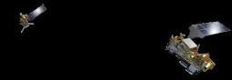
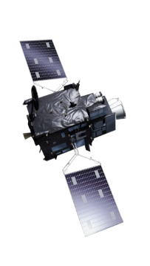
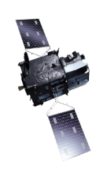

NWP SAF Support for Local Processing of Metop-SG A1
CSPP Users’ Group Meeting
19-21 May 2026
Nigel Atkinson

Slide 2
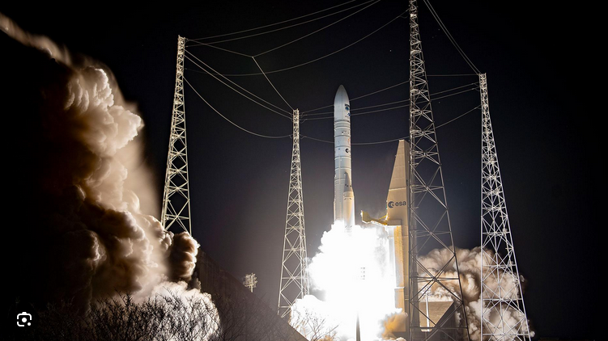
Metop-SG A1 (a.k.a. Metop-D)
Satellite launched 13 Aug 2025
Still in commissioning, but data now starting to flow
Direct broadcast is ready for users!

Slide 3
Processors for Metop-SG A1
The NWP SAF supports two sets of processors for Metop-SG A1:-
  Metop-SG Direct Broadcast software –
    Level 0 processor to go from VCDU to level 0
    Level 1 processor for each instrument – MWS, METimage (VII) and IASI-NG (IAS)
    All outputs are netCDF
    Status: The MWS and VII processors have been released. See https://nwp-saf.eumetsat.int/site/metop-sg-direct-broadcast-software/. IAS to follow soon.
  AAPP-SG (for sounders)
    Ingests the MWS level 1b and IAS level 1c files, and converts to BUFR, as required for DBNet
    Status: The NWP SAF review process is underway. As AAPP-SG is a new package, this is quite time consuming.

Slide 4
Part 1 – Metop-SG-A1 Direct Broadcast software

Slide 5
Responsibilities
Overall responsibility – EUMETSAT
“Re-engineering” of software for local mission use has been done by industry, under contract to EUMETSAT
Instrument package | Contractor
MWS | Exprivia / isardSAT
VII | Exprivia / isardSAT
IASI-NG | CNES / Thales
Distribution and user support – NWP SAF

Slide 6
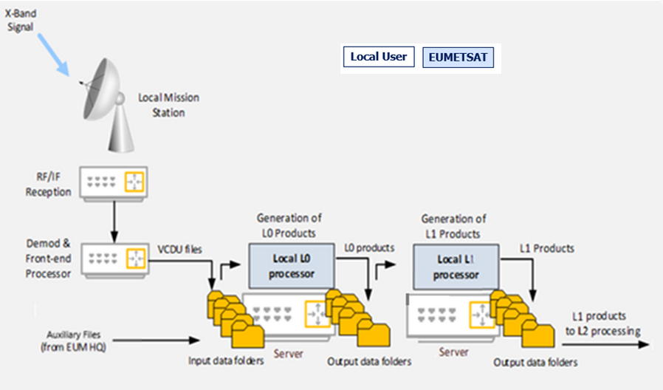
Local processors - overview
To AAPP-SG
This figure from the EUMETSAT Metop-SG Direct Readout guide

Slide 7
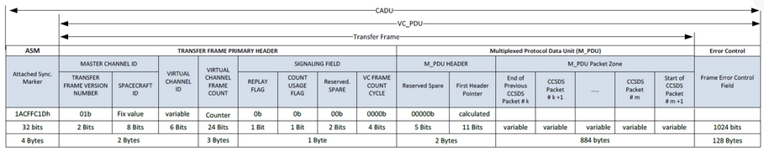
VCDU definition
The raw data stream comes encoded (Reed Solomon) and pseudo randomized, so the sync marker is not visible. It can be decoded with RT-STPS. This is typically done in real-time on the front-end (but can be done off-line if necessary).
The required VCDU, or “Transfer Frame” can be found straight after the sync marker. It is 892 bytes in length.
For efficiency, it is important to configure RT-STPS such that the instrument streams are separated. (Config file available on request).

Slide 8
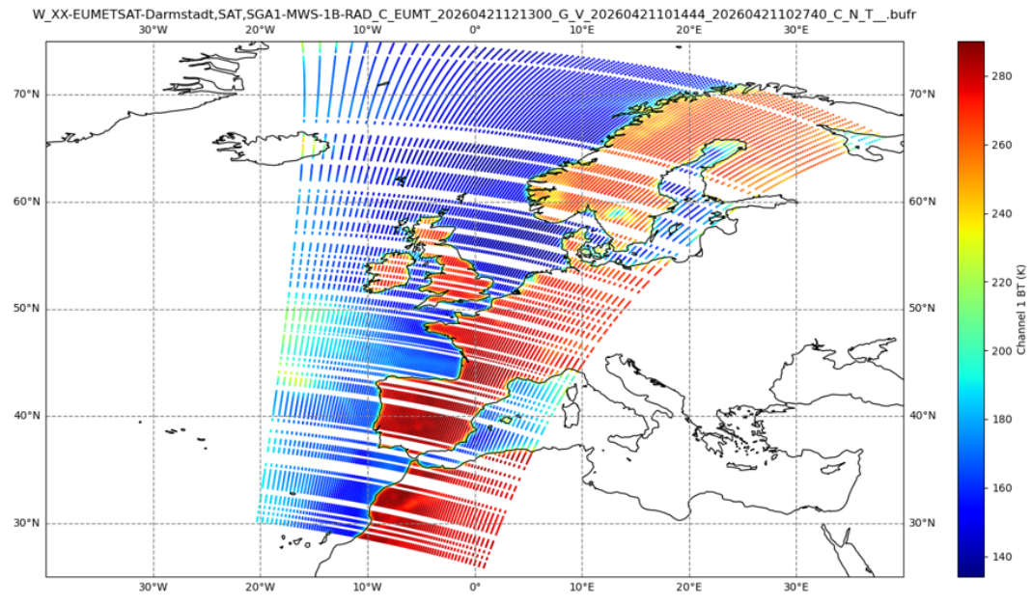
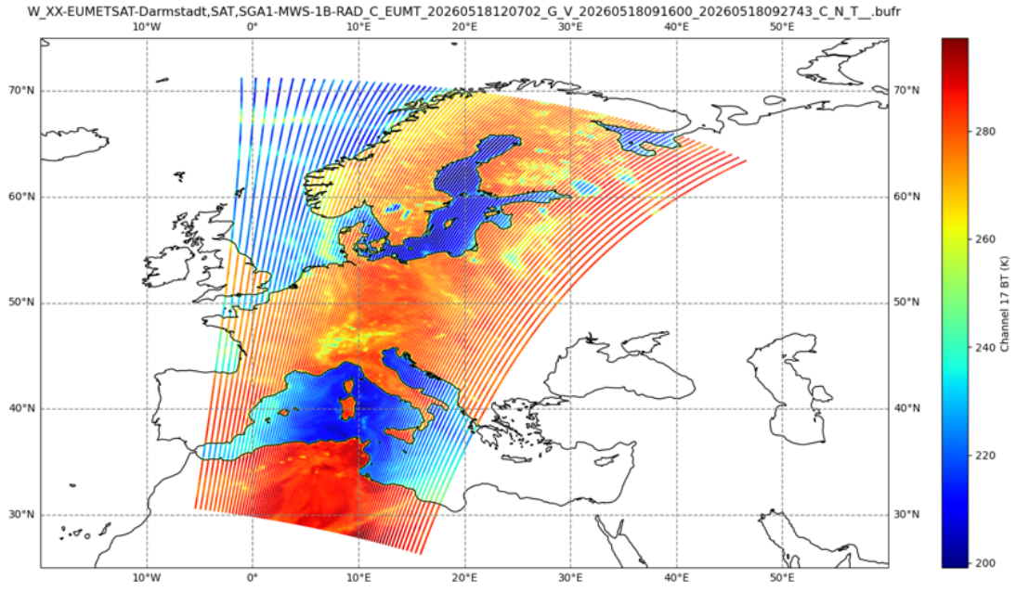
Running RT-STPS
Ideally, RT-STPS should be run on the front end while the acquisition is in progress – to save time
But for some systems this causes problems (see images)
At Exeter, we are now running RT-STPS after the “raw” file has been generated (thanks to SSEC for the suggestion)
BAD
GOOD!

Slide 9
Virtual channel numbers
We need the data for the following VCIDs:
  VCID9 – NAVATT
  VCID12 – IASI-NG
  VCID13 – MWS
  VCID16 – METimage
Our scripts assume that the “VCIDnn” string is present in the file name. If it isn’t then you should add it. There is no standard file name convention for VCDUs.

Slide 10
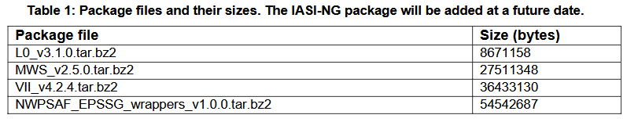
The local processors
All details are in the User Guide linked from https://nwp-saf.eumetsat.int/site/metop-sg-direct-broadcast-software/
Package files are available on the NWP SAF web site in the usual way, from the “software downloads” button. You have to tick the box for each processor that you require (for usage monitoring purposes).
Package files available now:

Slide 11
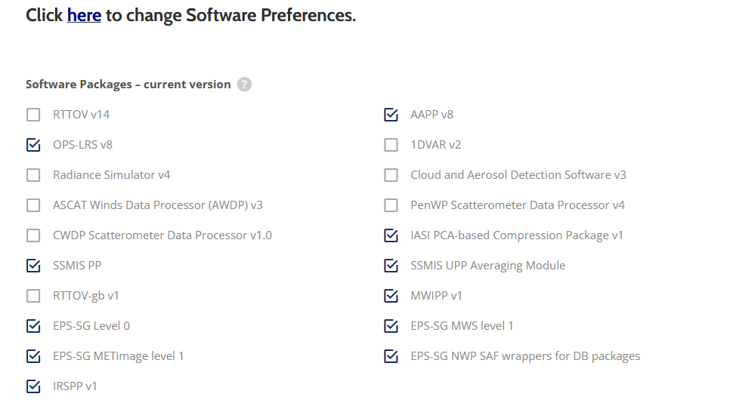
Selecting packages …

Slide 12
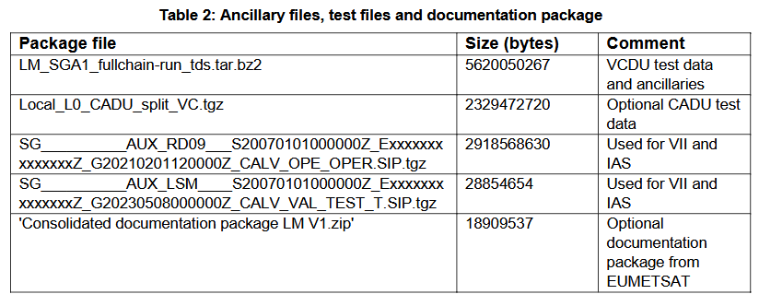
Ancillary files and test data
Download these from https://nwp-saf.eumetsat.int/downloads/epssg_db_ancillary_files/

Slide 13
Real-time ancillary files
Near-real-time ancillary files (notably predicted orbit files) will need to be downloaded from the EUMETSAT Data Store
You will need to set up an account for the EUMETSAT User Portal and to install the eumdac software. For details, see https://user.eumetsat.int/data-access/data-store
The NWP SAF scripts assume that eumdac is available in your PATH.
Predicted orbit file is checked daily.

Slide 14
Pre-built binaries
The packages were pre-built by EUMETSAT on RHEL9
The necessary dynamic libraries are included with the NWPSAF_EPSSG_wrappers
As well as running natively on RHEL9 we were also able to run them on our (rather old) RHEL7 servers via Rocky Linux 9 environment in Apptainer:
  apptainer build --sandbox rocky9/ docker://rockylinux:9
  apptainer shell rocky9
Alternatively, source code is included for L0, MWS and IAS, but if you need source code for METimage you should contact EUMETSAT Helpdesk due to Export Control restrictions.

Slide 15
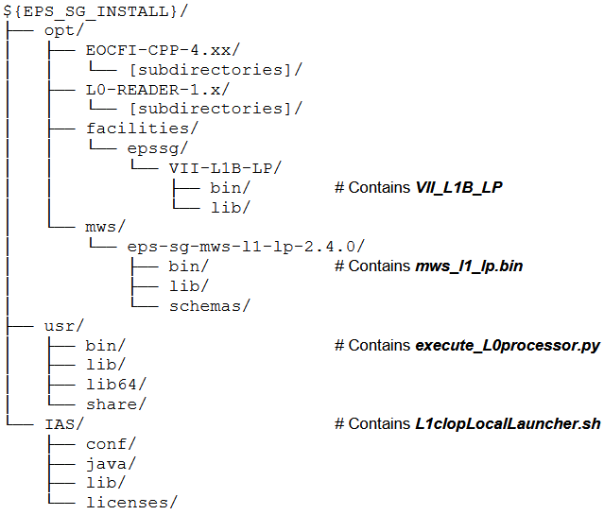
Installation
There is an installation script in the NWPSAF_EPSSG_wrappers package. The script unpacks each rpm file and installs into a directory of your choice – referred to by environment variable EPSSG_INSTALL. No admin privilege is needed.

Slide 16
Computing resources
MWS – can be run on a single core
METimage (VII) – at least 16 cores recommended
IASI-NG – at least 64 cores and 128GB memory recommended. It will run with fewer, but will be slow
We recommend that you start with MWS as that is easy and quick to run
Note also that IASI-NG processing requires VII to have been first processed to level 1b.

Slide 17
Running test cases
EUMETSAT have supplied test VCDU files. You can process these using the NWP SAF script run_EPSSG_test_data.sh
For example, to process MWS to level 1b:
  cd scripts
  export EPSSG_INSTALL=[installation directory]
  export EPSSG_DATA=[data directory]
  ./run_EPSSG_test_data.sh MWS
The script automatically copies all the fixed ancillary data from the package files into the data directory, the first time it is run.
A new test case will be posted soon, to support IASI-NG

Slide 18
Running your own real-time data
The main wrapper script is called run_EPSSG.sh. See the User Manual for details.
Remember that Metop-SG-A1 is still in commissioning and configuration files etc. may change at short notice. We will endeavour to post relevant information on the web page https://nwp-saf.eumetsat.int/site/metop-sg-direct-broadcast-software/

Slide 19
IASI-NG cloud mask
The IASI-NG L1C output includes an optional cloud mask derived from METimage
To generate the cloud mask, the NWCSAF’s PPS package is used
This complicates the processing flow … but you can run it without the cloud mask if you prefer.
See details in the User Manual.

Slide 20
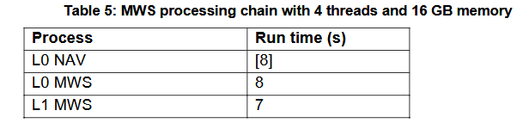
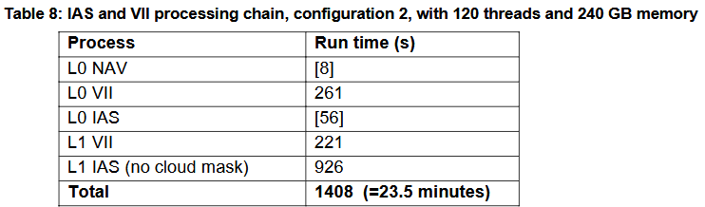
Run times
MWS is fast but IASI-NG takes significant time even without the cloud mask.
Potential speed-up if VII can be processed while the acquisition is in progress.
These figures are on the Met Office’s Microsoft Azure facility.
We have also procured new on-premises servers, but they are not built yet. Will test the packages on these servers ASAP.
RT-STPS run times not included!

Slide 21
Part 2 – AAPP-SG

Slide 22
AAPP-SG
AAPP-SG should be released late May 2026.
AAPP-SG includes facilities for processing MWS and IASI-NG (input netCDF files from the L1 processors)
MWS:
  Provision for spatial filtering and cloud/surface parameters
  Or you can just run the BUFR encoding, to match EUMETSAT global product
IASI-NG
  Includes the option of converting from level 1c (raw spectra) to level 1d (PC scores) – subject to availability of conversion matrices (EUMETSAT responsibility)
  Noting that IASI-NG is still in commissioning – level 1c spectra are stable but EUM are not yet in a position to disseminate level 1d.

Slide 23
AAPP-SG code
Written in Fortran90 – like other packages such as IRSPP and MWIPP
Prerequisites: ecCodes, netCDF (with Fortran interface), hdf5
A build script is provided

Slide 24
Status of BUFR sequences
MWS: The level 1b BUFR sequence is finalised and EUMETSAT are already distributing BUFR data to cal/val partners
IASI-NG: Whilst the IASI-NG level 1c BUFR sequence is fairly stable (though not finalised), the level 1d (PC scores) is not. AAPP-SG includes our best guess, to be updated later.

Slide 25
Other packages relevant to Metop-SG
Satpy (Pytroll) – for creating METimage imagery
NWC/PPS – includes METimage cloud mask
NWC/PPS-MW – in preparation by the NWCSAF
And others ...

Slide 26
Conclusion
Direct broadcast processors for MWS and METimage are available
IASI-NG coming soon.
Users should give it a try!
The NWP SAF welcomes feedback on your experiences

Slide 27
Thank you

